Slide 1
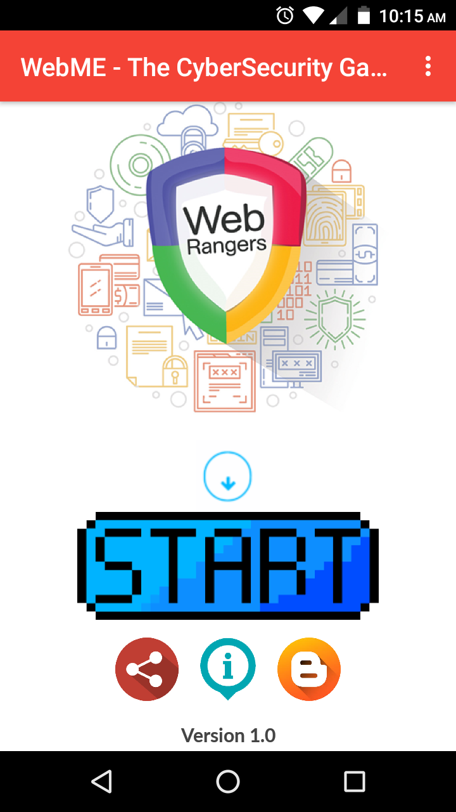
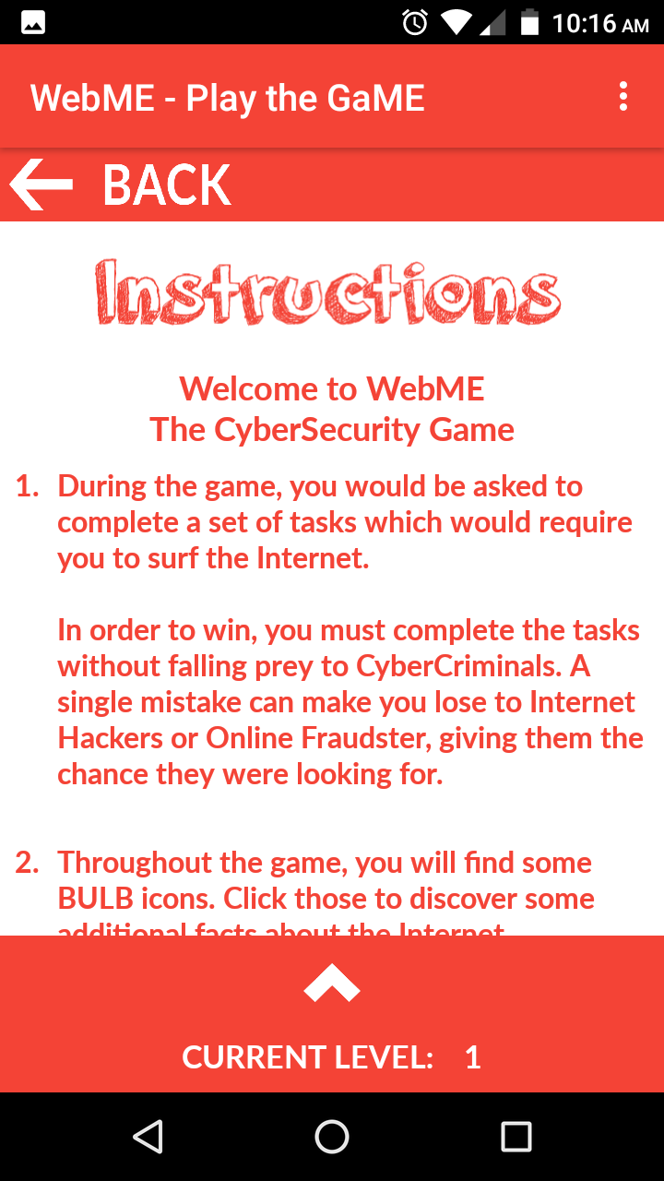
WebME - The CyberSecurity Game (Android only)
1K+
Downloads
The areas of focus of the levels include:
- Computer Networks and Security
- Online Malware
- Phishing
- Social Networking and Security
https://play.google.com/store/apps/details?id=com.thunkable.android.mrigankpawagi.WebME&hl=en_US

Slide 2

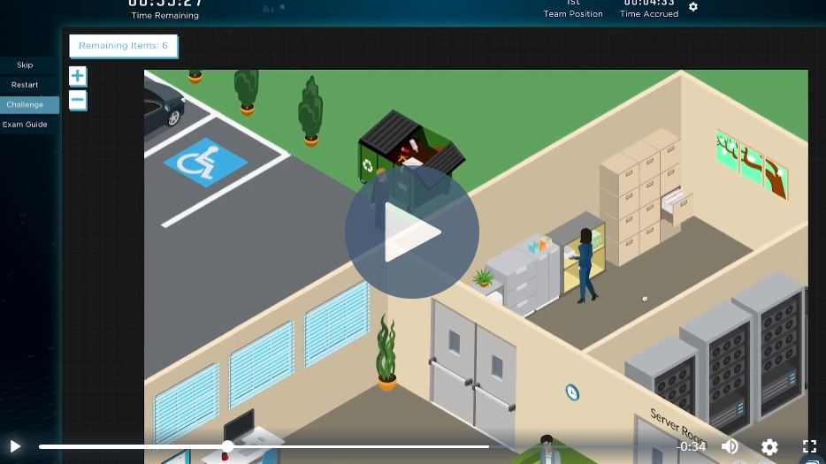
Living Security - Living Security’s CyberEscape Online
Completely remote, team based cybersecurity training platform
Participants work together to solve online puzzles in a race against the clock.
Content catalog is constantly updated so your teams have the latest installment to choose from.
https://www.livingsecurity.com/security-awareness-training-games/cyberescape-cybersecurity-escape-room

